Slide 1
Introduction to Crypto
1
Asset Tokenization
Kathryn Zhao
Denis Imaev

Slide 2
Introduction to Crypto
Everything is an Asset
Buildings, cars, music in your phone
How is asset ownership recorded?
Records must be secure, accessible, provable etc.
Stock ownership: recorded digitally by specialized corporations (custodians)
Real estate: some old-fashioned way…

Slide 3
Introduction to Crypto
Asset Ownership
Many middlemen involved: notaries, lawyers…
Lots of paperwork!!!
Ownership transfer is complex and costly
Ownership is not divisible: large and high value assets can only be owned by one entity
Prime assets are only accessible to the very wealthy

Slide 4
Introduction to Crypto
Asset ownership records: Blockchain
Transparent, provable and reliable
The owner can prove the rights by using private key
Easy transfer, just like funds (same transaction)
Access control: the record is visible to anyone, but only the owner can manipulate
Multiple owners

Slide 5
Introduction to Crypto
What is tokenization of RWA?
Through tokenization and blockchain technology, virtual counterparts of physical assets such as property, art, treasuries, and even luxury items like watches and jewelry can be created
This transformative process, known as asset tokenization or digitization, entails converting rights to assets into digital tokens —the act of connecting a product or asset to a digital token that is tradeable on a blockchain

Slide 6
Introduction to Crypto
Benefits of tokenization of RWA
These tokens can be securely and reliably bought, sold, and traded using blockchain technology
Effectively increase liquidity as well as lower costs and transaction times across markets
Operate with a speed and efficiency that a traditional bank or intermediary could only dream of
Other benefits include democratized ownership, better transparency, and global accessibility

Slide 7
Introduction to Crypto
Tokenomics
Tokenization of RWAs is one of the fastest-growing segments of DeFi, with more than $120 billion of real-world assets having been tokenized on blockchains
Ondo, Matrixdock and Mountain Protocol offer a suite of tokenized RWA products, ranging from short-term government bonds to higher risk corporate bonds

Slide 8
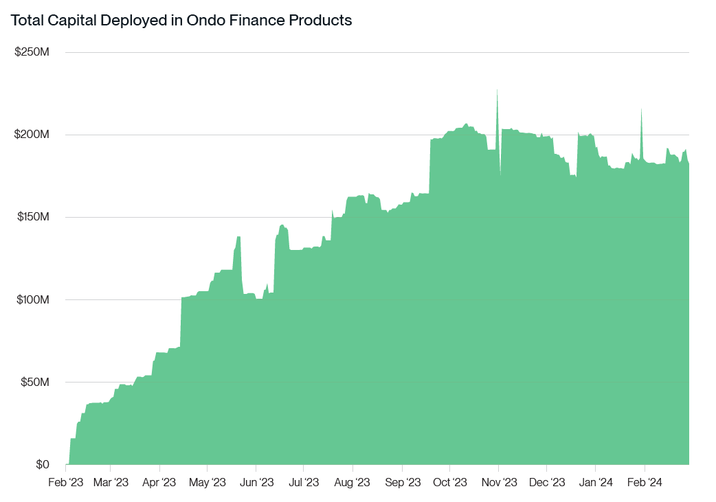
Introduction to Crypto

Slide 9
Introduction to Crypto
Tokenomics (cont.)
Superstate is another DeFi asset manager that issues tokenized RWA products
Asset management giants like Franklin Templeton launch a tokenized money market fund, FOBXX, which has gathered more than $430 million of assets
Blackrock issued BUIDL (Blackrock USD Institutional Digital Liquidity Fund) has amassed more than $550 million assets since launch

Slide 10
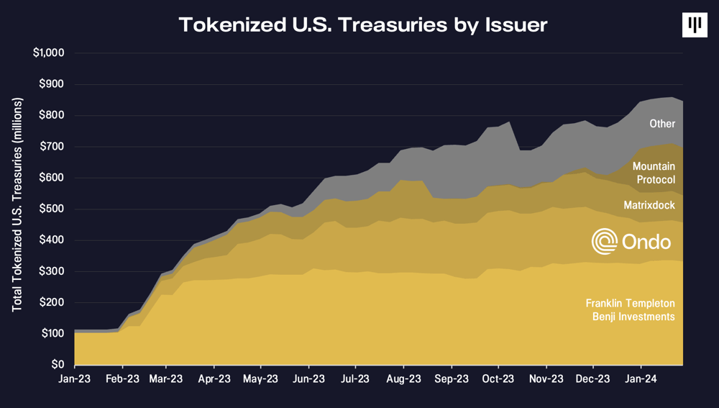
Introduction to Crypto
10

Slide 11
Introduction to Crypto
11

Slide 12
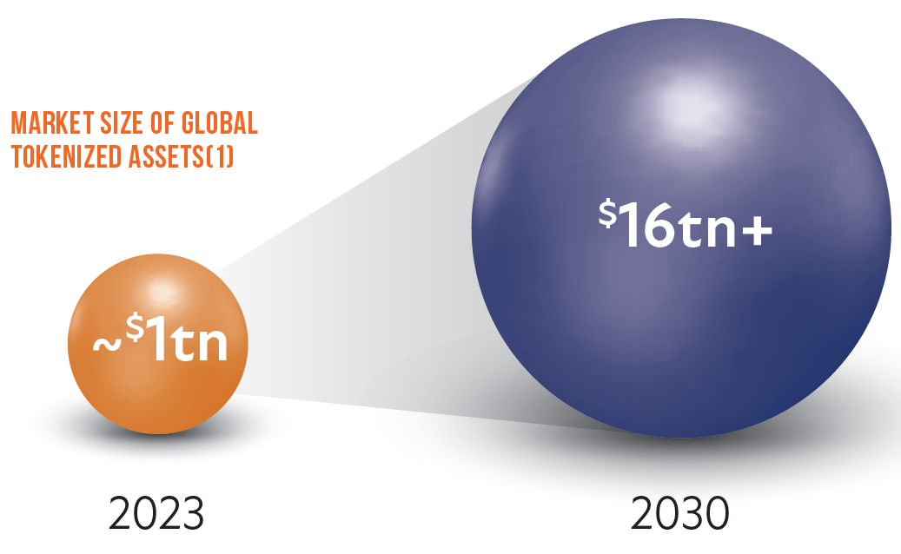
Introduction to Crypto

Slide 13
Introduction to Crypto
How does tokenization of RWA work?
The representation of an asset encompasses the essential and specific properties of an asset, such as measurements, expiration date, underlying price, entitlements, reserves, physical and transfer conditions, rights, and more
Tokenized assets can take two primary forms:
“off-chain”, representing ownership of a physical asset
“on-chain” token, solely existing within the digital realm

Slide 14
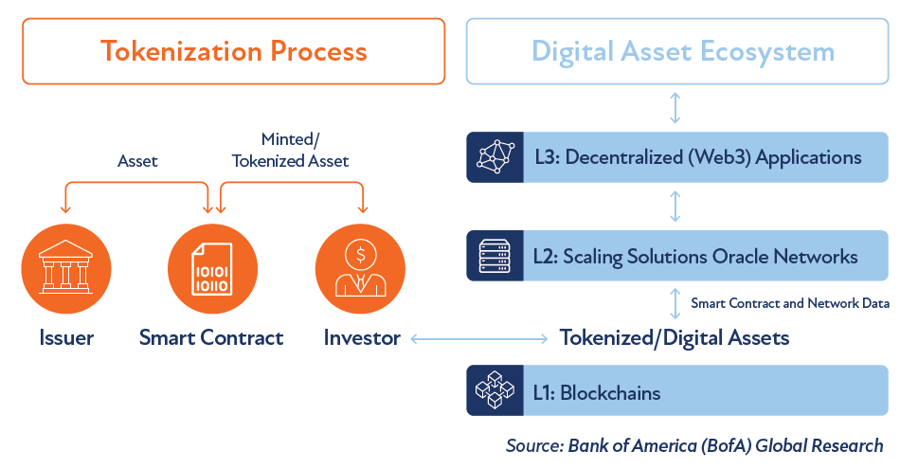
Introduction to Crypto
RWA Tokenization Infrastructure

Slide 15
Introduction to Crypto
RWA Tokenization Infrastructure (cont.)
Blockchain Technology
… Smart Contracts!
Legal and Regulatory Frameworks
Security and Identification: onboarding, KYC/AML
Blockchain Network Data: on-chain data, analytics
Oracles: provide off-chain data to smart contracts

Slide 16
Introduction to Crypto
Tokenization Process
Identification and Verification
Identify the asset(s) that will be tokenized
Tokenizable assets can be transferred or sold with a set or variable price
To determine prices and worth, assets are appraised

Slide 17
Introduction to Crypto
Tokenization Process
Legal Structuring and Compliance
Legal agreements must be established to define the terms of tokenization, including ownership rights, revenue sharing, and any other contractual obligations
These agreements can be encoded into self-executing smart contracts, ensuring automated and transparent enforcement of the agree-upon rules
Compliance with relevant regulations is also crucial

Slide 18
Introduction to Crypto
Tokenization Process
Token and Smart Contract Creation
Choose the blockchain
Ethereum, Solana, Avalanche, Stellar, etc.
Smart contracts underlying the digital tokens representing ownership are created on the blockchain

Slide 19
Introduction to Crypto
Tokenization Process
Distribution and Trading
The created RWA tokens are distributed to investors or participants who can then trade them on secondary markets
This introduces liquidity to traditionally illiquid assets, allowing for easier transfer of ownership
Ongoing management of the tokenized assets

Slide 20
Introduction to Crypto
Use Case: Fungible Tokens
Interchangeable
Powered by Ethereum token standards like ERC-20 or Bitcoin Runes
Examples:
Stablecoins
Commodities
Treasuries

Slide 21
Introduction to Crypto
Use Case: Non-Fungible Tokens
Smart contracts powered by Ethereum token standard ERC-721 or Bitcoin Ordinals
Examples:
Art and Collectibles
Real Estate
Intellectual Property and Royalties
Luxury Assets

Slide 22
Introduction to Crypto
Use Case: DePINs Take Off
Helium
By using Web3 incentives, it built a decentralized network of hotspots that together provide connectivity to IoT sensors
It incentivized people who don't know each other to work together and create the largest telecom network in history by combining their home Wi-Fi networks
It did this successfully by proving that the problem is in how the profit is distributed among the data providers

Slide 23
Introduction to Crypto
Use Case: DePINs Take Off (Cont.)
Wingbits
By applying a DePIN model to flight tracking, Wingbits is building a much fairer and more performant network where the data providers will get a share of the profits that their data generates, based on their performance and uptime
Wingbits rewards model makes sure that the best participants earn the most

Slide 24
Introduction to Crypto
Use Case: DePINs Take Off (Cont.)
Akash
Project Akash specifically allows you to rent tokenized physical computing resources for your AI model training
Market share: $50 billion in revenue by 2032
Akash offers GPUs resources at significantly lower costs, such as H100 GPUs at $1.50 per hour compared to Amazon's $12 per hour

Slide 25
Introduction to Crypto
DePIN: The New Industrial Evolution
Decentralized physical infrastructure networks (DePINs) use token rewards to incentivize the deployment of hardware-based networks and the completion of real-world tasks
At their core, DePINs are decentralized marketplaces that connect suppliers of a resource with buyers
Key difference: who the stakeholders are?

Slide 26
Introduction to Crypto
Benefits of DePINs?
Robust, resilient, and secure
Affordability for users
Community-driven decision making
Growing the gig economy
Better products and services

Slide 27
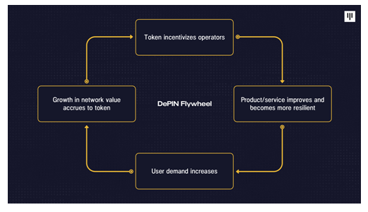
Introduction to Crypto
DePIN Flywheel

Slide 28
Introduction to Crypto
Case Studies of DePINs
GEODNET
The world’s largest decentralized Real Time Kinematics (RTK) network powered by a community of satellite miners to enable IoT at scale
Hivemapper
A decentralized mapping network that uses cryptocurrency incentives to crowdsource high-quality, up-to-date global map data

Slide 29
Introduction to Crypto
Challenges of DePINs?
Balancing supply and demand through targeted incentives
Network scalability and stability
Competition from large established players
Regulatory challenges cross jurisdictions
High upfront costs for contributors
Execution risk in managing a complex token reward system

Slide 30
Introduction to Crypto
Recap: Advantages of Tokenization
Tokenizing RWA creates opportunities for both asset managers and investors by offering cost savings, expediting transaction processes, and creating a more equitable market
Efficient transactions
Greater liquidity
Lowered costs
Transparent environment
New financial products

Slide 31
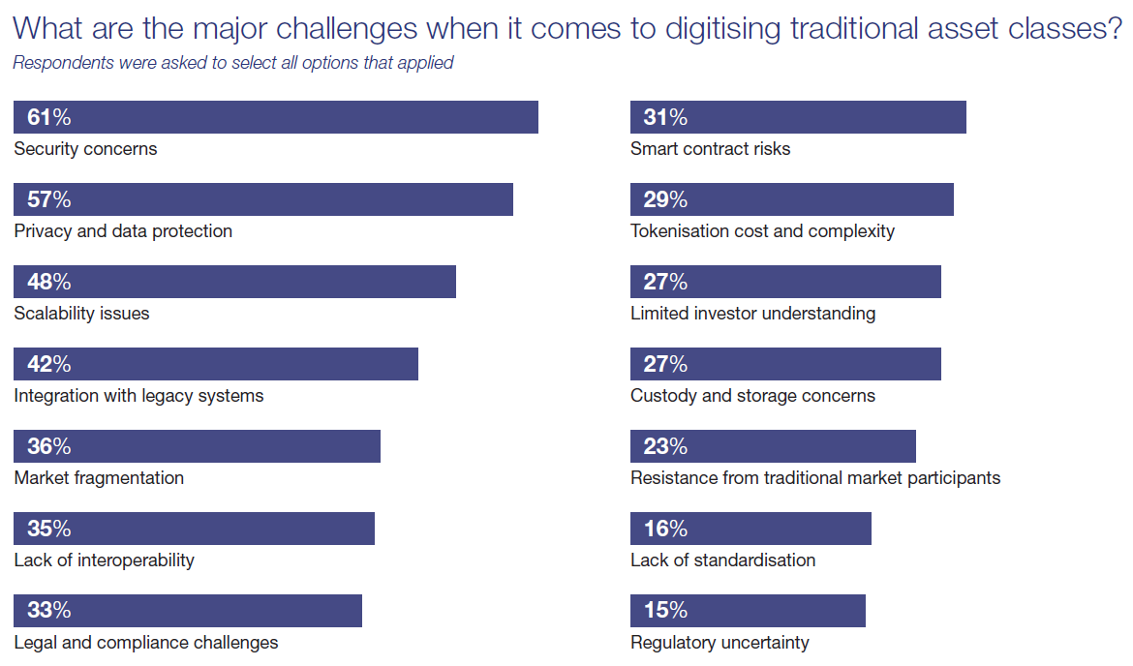
Introduction to Crypto

Slide 32
Introduction to Crypto
Who is in?
72% of global finance professionals expect to explore tokenization as a means of driving innovation by 2026
Large banks and other institutions have started tokenizing financial products they already trade, such as gold, stocks, and commodities
Different initiatives and proof of concepts are being conducted around the world

Slide 33
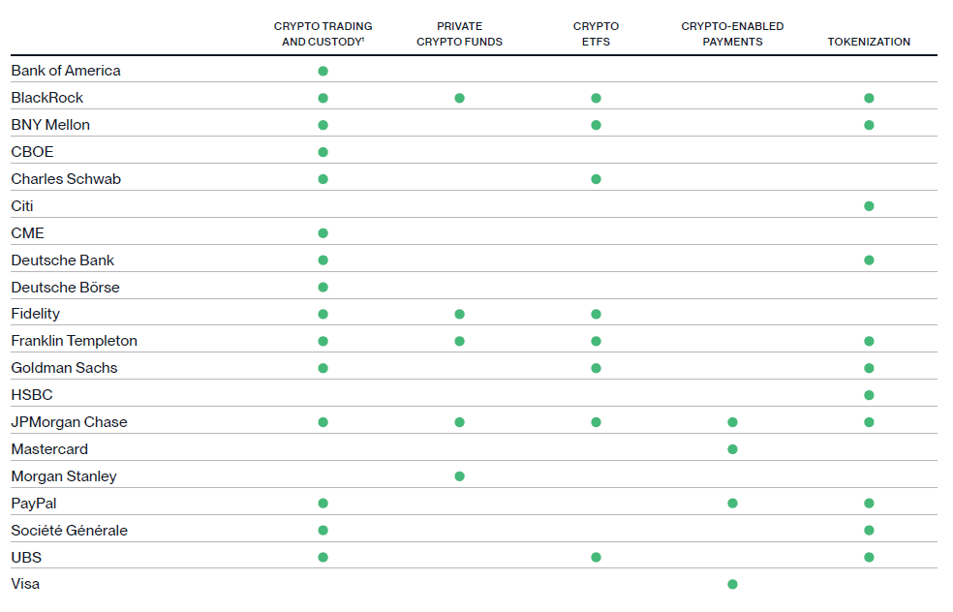
Introduction to Crypto
Crypto Adoption by Institutions

Slide 34
Introduction to Crypto
Who is in?
HKMA Opened its tokenization "Project Ensemble“ sandbox
The project is meant to future-proof the financial system
Major institutions, including HSBC, Global Shipping Business Network, and HashKey, rushed in
HSBC bank completed three proof of concepts

Slide 35
Introduction to Crypto
Who is in?
EIB issued its first digital bond on the public Ethereum network
Franklin Templeton launched Franklin OnChain US Government Money Fund on Stellar and Polygon blockchains
KKR tokenized a healthcare fund on Avalanche with Securitize
JPMorgan’s Onyx Digital Assets Network enables the tokenization of deposits for settlements of assets such as US Treasuries and money market products

Slide 36
Introduction to Crypto
36
Who is in?
HSBC Holdings Plc launched a new system to tokenize ownership of physical gold held in its London vaults
Euroclear switched on a blockchain platform for issuing traditional securities
Fidelity International launched a money market fund on chain

Slide 37
Introduction to Crypto
37
Who is in?
Goldman Sachs is launching 3 tokenization projects by EOY 2024
One will target the U.S. fund sector while the others on European debt markets
Coinbase Asset Management is creating a tokenized money market fund
It will start tokenizing traditional assets on Base, the exchange’s Ethereum scaling network

Slide 38
Introduction to Crypto
38
Who is in?
Ripple will allocate $10mm to a tokenized version of US treasury bills available on the XRP ledger by the tokenization platform OpenEden
State Street is partnering with digital asset custodian Taurus for its tokenization plans with the intention of extending to crypto custody once the US regulatory environment improves

Slide 39
Introduction to Crypto
Trustless or Not
Intermediaries take on new dimensions
Sandbox regimes (Central Securities Depositories)
Efficiency is not always the endgame
Current blockchain technologies for tokenization of RWAs
Limited scale
Lack of interoperability
Absence of privacy

Slide 40
Introduction to Crypto
Conclusion
RWA tokenization is poised to drive greater efficiency, accessibility, and transparency
Revolutionizing how we perceive, access, and interact with financial system and currency
Reshaping traditional investment practices and paving the way for innovative financial products and services
Market cap and utilization projections suggest significant growth

